Slide 1
Services Integration
SE495: Software and Systems Integration

Slide 2
Outline
Introduction
Integration Types
Integration Models
Integrated system vs. Legacy System
Integration type
Integration Architecture

Slide 3
Integration/Composition
How services can interact over the network?
APIs:
Commands- actions, synchronous
Messages- request for information, no state change, synchronous
Events: facts and notifications, asynchronous
Streams: a sequence of events/data elements made available over time

Slide 4
Types
Learn the differences between an event-driven streaming platform like Apache Kafka and middleware like Message Queues (MQ), Extract-Transform-Load (ETL) and Enterprise Service Bus (ESB).
Including best practices and anti-patterns, but also how these concepts and tools complement each other in an enterprise architecture.

Slide 5
Problems of Legacy Middleware
Extract-Transform-Load (ETL) is still a widely-used pattern to move data between different systems via batch processing.
Due to its challenges in today’s world where real time is the new standard, an Enterprise Service Bus (ESB) is used in many enterprises as integration backbone between any kind of microservice, legacy application or cloud service to move data via SOAP / REST Web Services or other technologies.
Stream Processing is often added as its own component in the enterprise architecture for correlation of different events to implement contextual rules and stateful analytics.
Using all these components introduces challenges and complexities in development and operations.

Slide 6
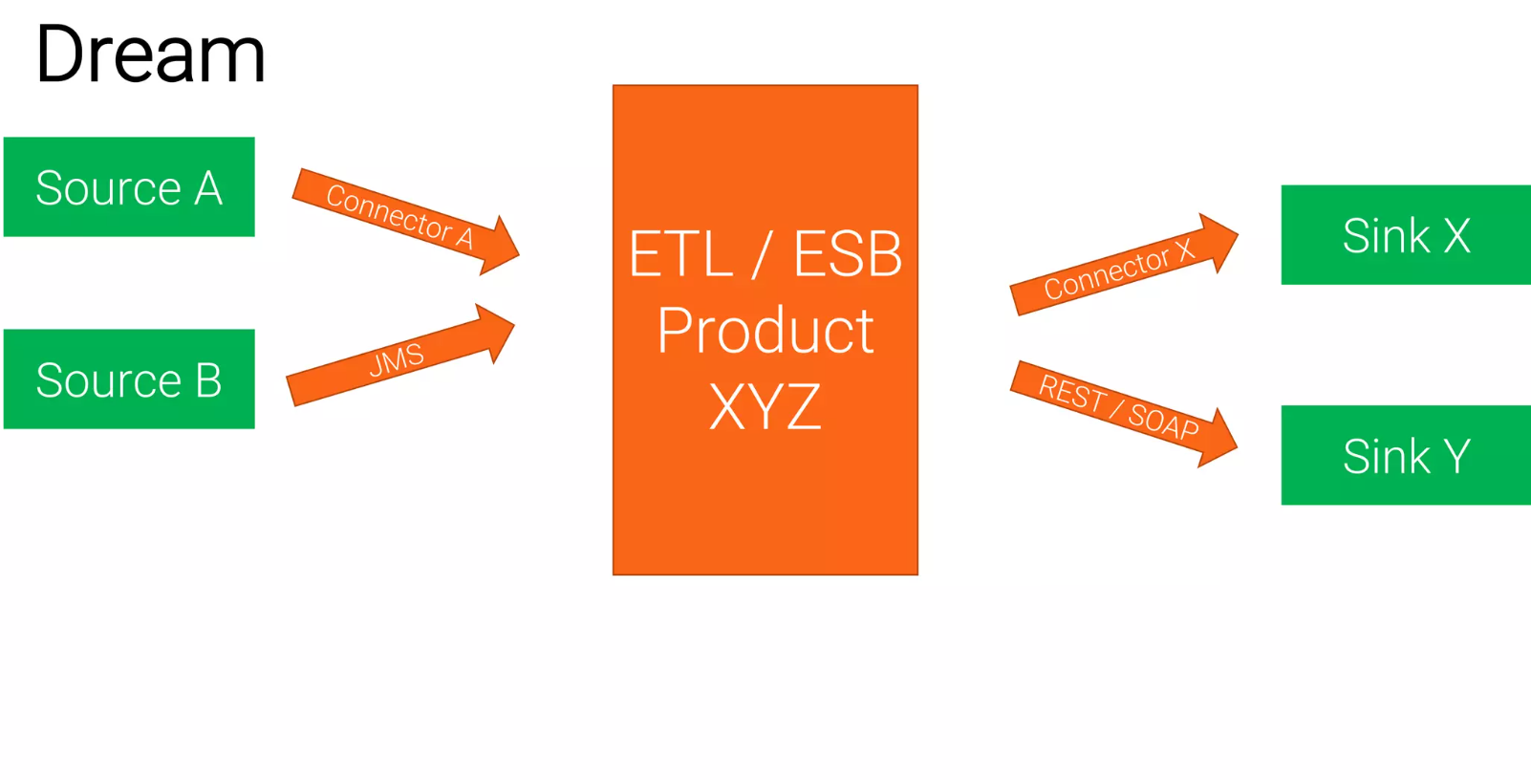
Traditional Middleware

Slide 7
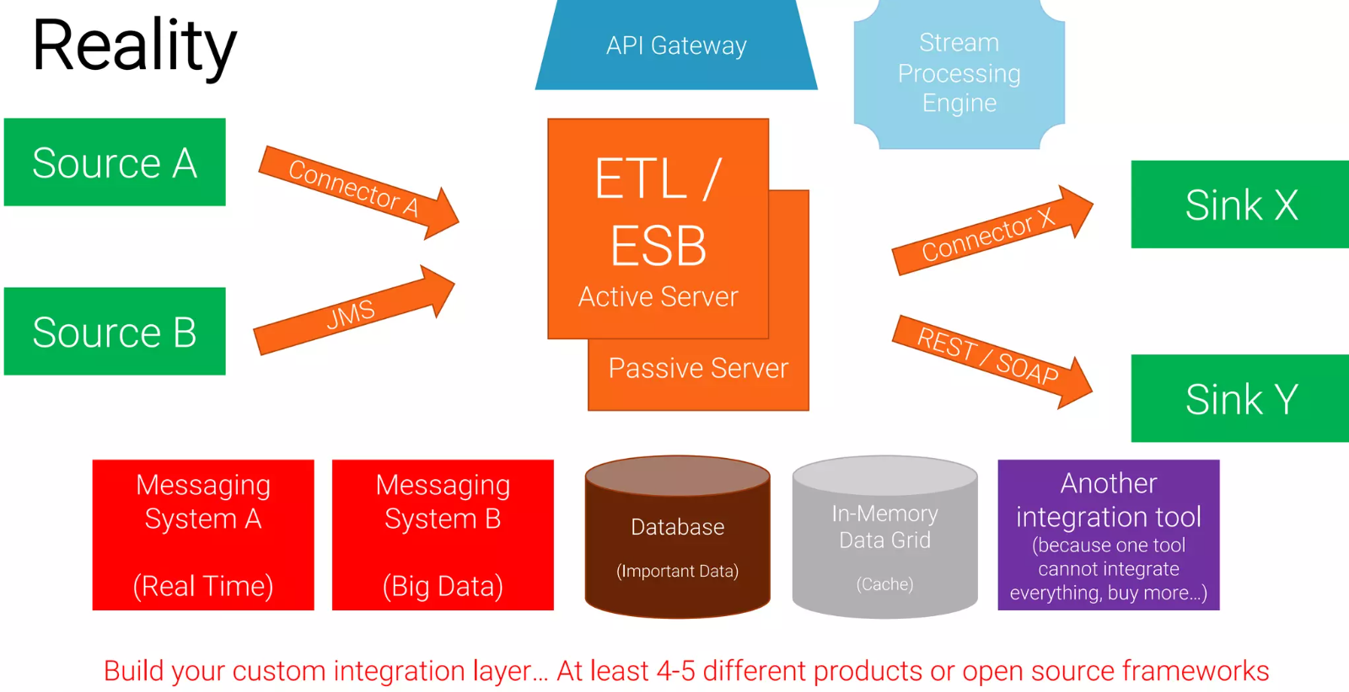
Traditional Middleware

Slide 8
Challenges (MQ, ETL, ESB)
Zoo of technologies
Integration platform (ETL/ESB) + additional optional components
Database
APIs
Architecture with limited scalability and availability
No end-to-end, no native built-in scalability
Downtime for maintenance
Tight Coupling
No separation of concerns and vendor lock-in

Slide 9
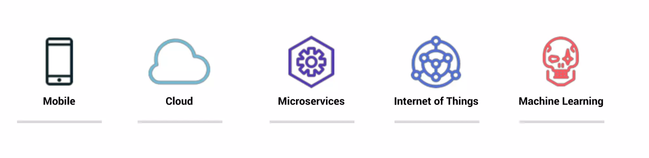
The World Has Changed
Business Digitalization Trends are driving the need to process events at a whole new scale, speed, and efficiency

Slide 10
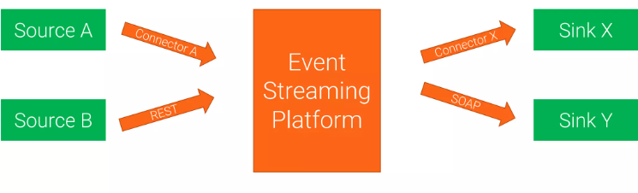
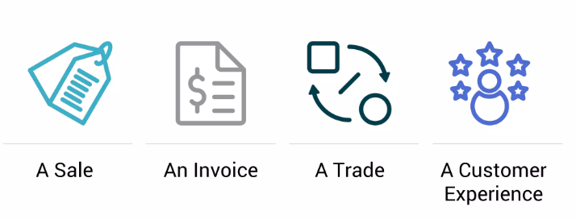
Event Streaming Platforms
Events

Slide 11
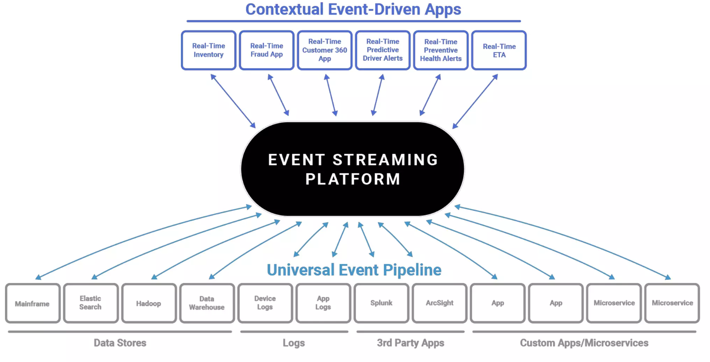

Slide 12
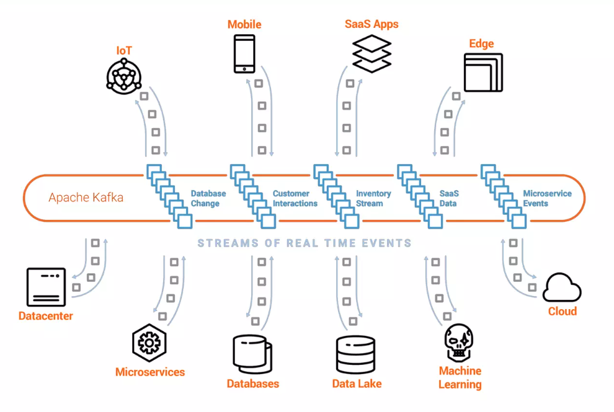
Apache Kafka
Global-scale
Real-time
Persistent Storage
Stream Processing

Slide 13
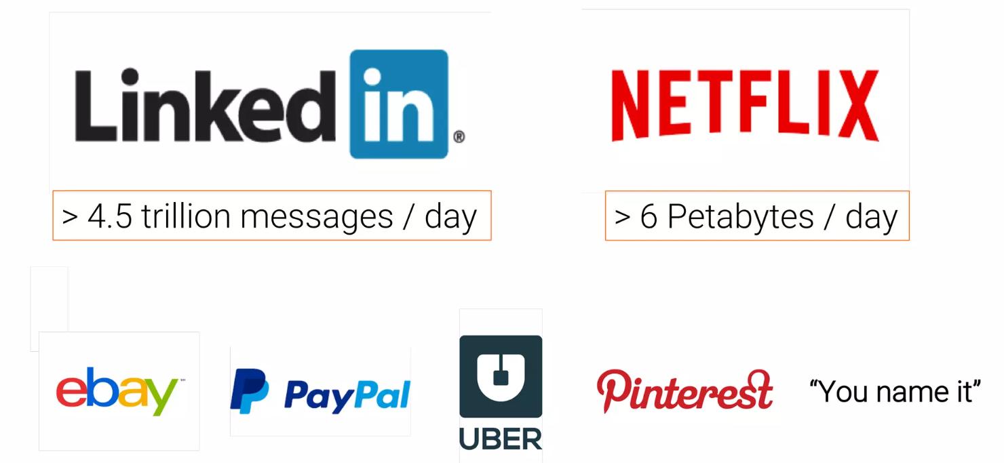
Kafka at Scale

Slide 14
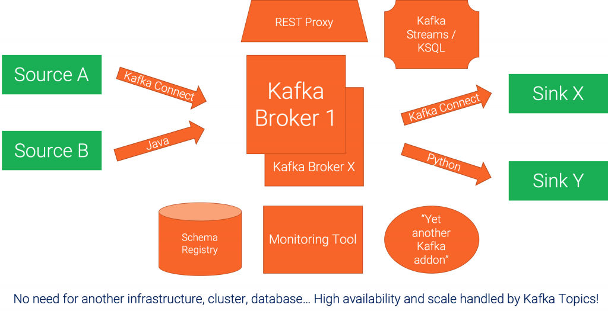
A concrete example architecture

Slide 15
Comparison: Apache Camel vs. Apache Kafka
Should I use Apache Camel or Apache Kafka for my next integration project?
The question is very valid and comes up regularly.
We are going to explore both open-source frameworks and explains the difference between application integration and event streaming.
The comparison discusses when to use Kafka or Camel, when to combine them, when not to use them at all.
A decision tree shows how you can quickly qualify out one for the other.

Slide 16
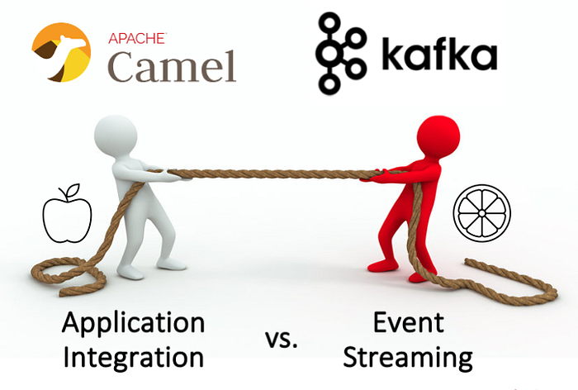

Slide 17
Comparison
Application integration (= Camel) and event streaming (= Kafka) play a critical role in every modern enterprise architecture.
Open-source is widely adopted and usually preferred compared to proprietary solutions for various reasons, including avoiding vendor lock-in.
That’s true for self-managed and serverless cloud offerings.

Slide 18
Comparison
Hence, the question arises: Should I use Apache Camel for application integration or Apache Kafka for event streaming? Or both? Or does one solve the other, too?
These questions will be answered in the following sections, concluding with a decision tree to help you make the right choice for your project.
Let’s look at the similarities between Camel and Kafka, when to use which framework, when and how to combine them, and when not to use them at all.

Slide 19
Features in Apache Camel AND Apache Kafka
Open source under Apache 2.0 license
Vibrant community and adoption in the industry
Mature framework with deployments in enterprises across the globe
Fixing point-to-point spaghetti architectures with a central integration backbone
Open architecture and extensibility with custom functions and connectors
Small and big deployments possible, plus single-node deployments for non-mission-critical use cases
Re-engineered and optimized for cloud-native deployments (container, Kubernetes, cloud)
Connectivity to any technology, API, communication paradigm, and SaaS
Transformation of any data types and formats
Processes transactional and analytical workloads
Domain-specific language (DSL) for message at a time processing, with similar logic such as aggregation, filtering, conditional processing
Relative complex frameworks because of their robust feature set, hence not suitable for solving a minor problem
Not a replacement of a database, data warehouse, or data lake

Slide 20
Features in Apache Camel AND Apache Kafka
Beyond the similarities, Kafka and Camel have very different sweet spots built to solve distinct problems.
Hence, comparing these two tools is a bit comparison of apples and oranges.
Some minor projects might use one or the other to solve the problem, but critical enterprise projects show the differences more quickly.

Slide 21
When to use Apache Camel?
The mission of Camel
Apache Camel is an integration framework.
It solves a particular problem: Data integration between different applications, APIs, protocols, and communication paradigms.
This concept is often called application integration or enterprise integration.
Camel implements the famous Enterprise Integration Patterns (EIP).
EIPs are based on messaging principles.

Slide 22
Camel’s strengths
Event-based backbone based on well-known and adopted EIP concepts
Connectivity to almost any API
Integration, processing, and routing of information with an intuitive domain-specific language (DSL) with a focus on integration; providing the ability of composability in a programming context for finer grain control in code for doing conditional logic or transformations/reformatting
Powerful routing capabilities with many built-in EIPs
Many deployment options (standalone, web container, application server, Spring, OSGi, Kubernetes via the Camel K sub-project) — okay, I guess some options are not relevant in this decade anymore :-)
Lightweight alternative to proprietary ETL and ESB tools

Slide 23
Camel’s weaknesses
Only a “routing machine”, i.e., not built for long-term storage (additional cache or storage needed), for that reason, Camel is not the right choice for a central nervous system like Kafka
No stream processing (like you know it from Kafka Streams or Apache Flink)
Limited scalability, not built for massive volumes of data
No powerful visual coding like you know it from proprietary ETL/ESB/iPaaS tools
No serverless cloud offering, with that also not competing with other iPaaS offerings
Red Hat is the only vendor supporting it
Built to be deployed in a single data center or cloud region, not across hybrid or multi-cloud scenarios

Slide 24
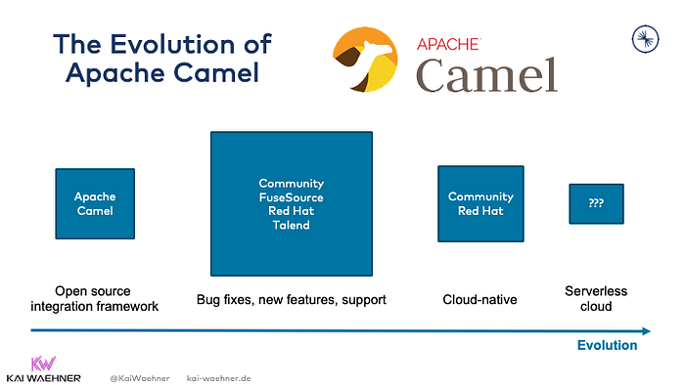
The evolution of Apache Camel

Slide 25
Camel TL;DR
Camel is an application integration framework to connect different applications and interfaces.
Camel is NOT built for processing data in motion continuously, i.e., stream processing.
Hence, it should be compared to ETL and ESB tools, not data streaming technologies like Kafka, Kinesis, or Flink.
If you look for a serverless cloud offering, you are out of luck.
If you look for vendor support, Red Hat is the only option.

Slide 26
When to use Apache Kafka?
The mission of Kafka
Real-time data beats slow data at any scale.
The event streaming platform enables processing data in motion.
Kafka is the de facto standard for event streaming, including messaging, data integration, stream processing, and storage.
Kafka provides all capabilities in one infrastructure at scale.
It is reliable and allows to process analytics and transactional workloads.

Slide 27
Kafka’s strengths
Event-based streaming platform
A unique combination of pub/sub messaging, data processing, data integration, and storage in a single framework
Built for massive volumes of data and extreme scale from the beginning, with that a single framework can be used for transactional (low volume) and analytics (high volume) use cases
True decoupling between producers and consumers because of its storage component makes it the de facto standard for microservice architectures
Guaranteed ordering of events in the distributed commit log
Distributed data processing with fault-tolerance and recoverability built-in
Replayability of events
The de facto standard for event streaming
Built with hybrid and multi-cloud data replication in mind (with included tools like MirrorMaker and separate, more advanced, and more straightforward tools like Confluent Cluster Linking)
Support from many vendors, including Confluent, Cloudera, IBM, Red Hat, Amazon, Microsoft, and many more
Paradigm shift: Built to process data in motion end-to-end from source to one or more sinks

Slide 28
Kafka’s weaknesses
Paradigm shift: Enterprises need to learn and understand the added value of event streaming, a new software category that enables new use cases but also requires different design patterns and operations approaches
No powerful visual coding like you know it from proprietary ETL/ESB/iPaaS tools
Limited out-of-the-box routing capabilities (Kafka Connect SMT or Kafka Streams / ksqlDB app do the job very well, but not as simple as Camel)
Complex operations (if you run it by yourself instead of using 3rd party tools or even better a serverless cloud offering)

Slide 29
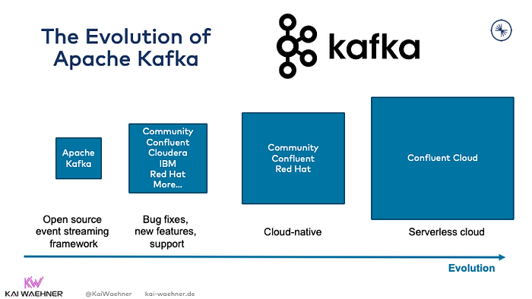
The evolution of Apache Kafka

Slide 30
Kafka TL;DR
Kafka is an event streaming platform to process data in motion continuously.
If you “just” need an integration framework to route data from a source to one or more sinks (= ETL / ESB), then Camel can be used, too.
However, Kafka kills two birds with one stone (= integrating data AND processing it in motion where needed).
Plenty of Kafka offerings are available on the market.
Check out the Apache Kafka landscape and comparison to understand the differences between offerings from Confluent, Cloudera, IBM, Red Hat, Amazon, Microsoft, and others.

Slide 31
Decision tree — Camel or Kafka?
Both frameworks overlap with their capabilities
Qualify out, Do you need:
Big data processing?
A storage component for true decoupling and replayability of events?
Stateless or stateful stream processing?
A serverless cloud offering?
Qualifying out solutions because of their limitations makes the decision tree and evaluation process much easier from the beginning.

Slide 32
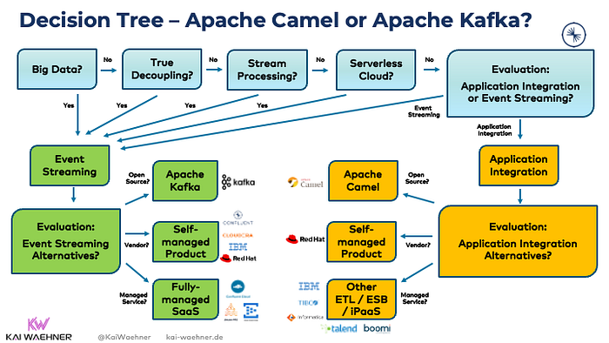
Decision tree — Camel or Kafka?

Slide 33
When to use Camel and Kafka together?
It is possible to use Camel and Kafka together in a single integration architecture.
Should you do that? Two options exist. One makes more sense than the other:
Kafka for event streaming and Camel for ETL

Slide 34
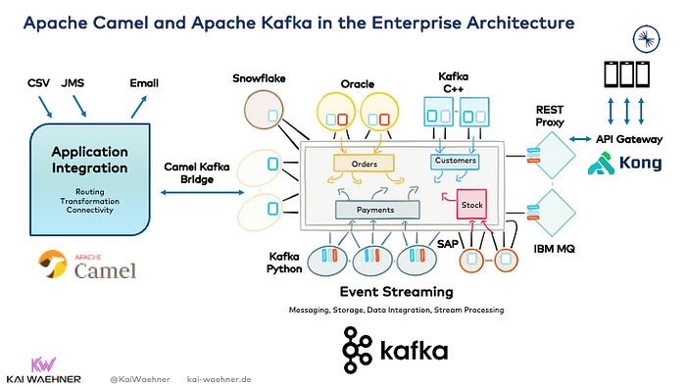

Slide 35
When to use Camel and Kafka together?
Once again, the vast advantage of Kafka as central integration layer is its unique combination of characteristics within a single infrastructure, including:
Real-time messaging at any scale
Storage for true decoupling between different applications and communication paradigms
Built-in backpressure handling and replayability of events
Data integration
Stream processing

Slide 36
When NOT to use Camel or Kafka at all?
Both Camel and Kafka are NOT built for the following scenarios:
A proxy for millions of clients (like mobile apps) — but native proxies (like a REST or MQTT Proxy for Kafka) exist for some use cases.
An API Management platform — but these tools are usually complementary and used to create life cycle management or monetize APIs deployed with Camel or Kafka.
A database for complex queries and batch analytics workloads
an IoT platform with features such as device management — but direct native integration with (some) IoT protocols such as MQTT or OPC-UA is possible and the approach for (some) use cases.
A technology for hard real-time applications such as safety-critical or deterministic systems — but that’s true for any other IT framework, too. Embedded systems are a different software than Camel or Kafka!

